Slide 1


FACILITATOR DECK
PSIRA Grade E, D & C Security Training
A structured teaching sequence for explanation, discussion, practice and assessment readiness.
SAFE • LAWFUL • PROFESSIONAL
Notes:
Welcome learners, confirm the course scope and explain that practical competence requires active participation, not reading alone.
[Sources]
- Mupo Security Training, Grade E, D & C Training Manual, Publication Ready Edition 2.1 (user-provided).
- User-provided Mupo Training Center and Mupo Security Training logos and manual illustrations.
[/Sources]

Slide 2
MUPO TRAINING CENTER
COURSE PURPOSE
The goal is confident, safe and lawful performance
By the end, learners should be able to:
01
UNDERSTAND
Explain the core duties, limits and risks of security work.
02
APPLY
Choose site-appropriate actions in realistic situations.
03
EVIDENCE
Communicate, record and demonstrate competence clearly.
GRADE E, D & C | 02
Notes:
Ask learners what competent security performance looks like. Link their answers to knowledge, application and evidence.
[Sources]
- Mupo Security Training, Grade E, D & C Training Manual, Publication Ready Edition 2.1 (user-provided).
- User-provided Mupo Training Center and Mupo Security Training logos and manual illustrations.
[/Sources]

Slide 3
MUPO TRAINING CENTER
LEARNING JOURNEY
Eighteen modules build from personal conduct to site protection
PHASE 1
PHASE 2
PHASE 3
01 Personal Hygiene and General Appearance
07 Observation
13 Occupational Safety
02 Public Relations
08 Guarding and Patrolling
14 Access Control
03 Role and Function of Security
09 Firefighting, Prevention and Protection
15 Search Procedures and Techniques
04 Recognition of Bombs, Explosive Devices and Firearms
10 Radio and Telephone Communication
16 Pocketbooks and the Occurrence Book
05 Discipline and Professional Conduct
11 Legal Aspects
17 Written Reports
06 Basic Self-Defence and Personal Safety
12 Industrial Relations
18 The Threat
GRADE E, D & C | 03
Notes:
Orient learners to the sequence. Explain that later modules rely on observation, communication, legal awareness and accurate records introduced earlier.
[Sources]
- Mupo Security Training, Grade E, D & C Training Manual, Publication Ready Edition 2.1 (user-provided).
- User-provided Mupo Training Center and Mupo Security Training logos and manual illustrations.
[/Sources]

Slide 4
MUPO TRAINING CENTER
DELIVERY APPROACH
Use a repeatable rhythm for every learning unit
01
02
03
04
EXPLAIN
DISCUSS
PRACTISE
CHECK
Introduce the rule and why it matters.
Connect the rule to learners’ experience.
Use a scenario, role-play or site walk-through.
Confirm knowledge, application and evidence.
Facilitator principle: explain less, ask more, observe carefully and correct unsafe reasoning immediately.
GRADE E, D & C | 04
Notes:
Use this rhythm throughout the course. Keep explanations concise and allocate time for learner talk, demonstration and feedback.
[Sources]
- Mupo Security Training, Grade E, D & C Training Manual, Publication Ready Edition 2.1 (user-provided).
- User-provided Mupo Training Center and Mupo Security Training logos and manual illustrations.
[/Sources]

Slide 5
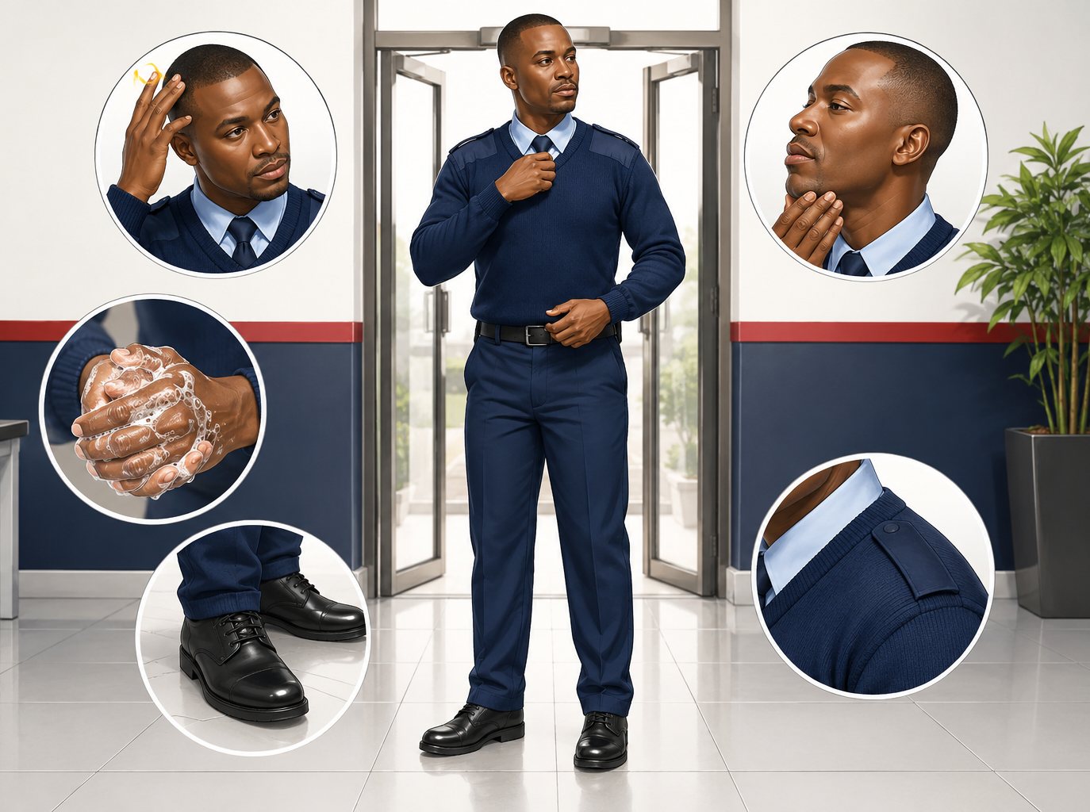
MUPO TRAINING CENTER
MODULE 1
MODULE 01 • 60 MINUTES
Personal Hygiene and General Appearance
TEACH THE ESSENTIALS
• Report for duty clean, rested and correctly dressed in a complete uniform.
• Bathe regularly; keep hands, nails, teeth, hair and feet clean.
• Wear clean clothing and socks and keep footwear presentable.
FACILITATE
A colleague arrives for duty in a soiled uniform and appears unwell. Explain a respectful, safety-conscious response.
GRADE E, D & C | 05
Notes:
Module 1: Personal Hygiene and General Appearance. Explain the essential knowledge, then use the scenario to elicit a safe sequence of actions. Ask learners to justify what they would communicate and record.
[Sources]
- Mupo Security Training, Grade E, D & C Training Manual, Publication Ready Edition 2.1 (user-provided).
- User-provided Mupo Training Center and Mupo Security Training logos and manual illustrations.
[/Sources]

Slide 6
MUPO TRAINING CENTER
MODULE 2
MODULE 02 • 90 MINUTES
Public Relations
TEACH THE ESSENTIALS
ASK
• A security officer is often the first point of contact at a site.
• Be helpful, courteous, friendly and dignified while enforcing rules.
• Use clear, respectful language; listen before responding.
• Maintain a professional attitude, full uniform and good manners.
A visitor becomes impatient when asked to sign in. Demonstrate how to enforce the rule while preserving good relations.
Evidence to listen for
Communicate respectfully with the public and client representatives.
GRADE E, D & C | 06
Notes:
Module 2: Public Relations. Explain the essential knowledge, then use the scenario to elicit a safe sequence of actions. Ask learners to justify what they would communicate and record.
[Sources]
- Mupo Security Training, Grade E, D & C Training Manual, Publication Ready Edition 2.1 (user-provided).
- User-provided Mupo Training Center and Mupo Security Training logos and manual illustrations.
[/Sources]

Slide 7
MUPO TRAINING CENTER
MODULE 3
MODULE 03 • 90 MINUTES
Role and Function of Security
TEACH THE ESSENTIALS
ASK
• Security protects information, material and assets, and people.
• Apply need-to-know principles to sensitive information.
• A vulnerable area is relatively easy to penetrate or difficult to observe.
• A vital point is essential to operations, such as a control room or power supply.
During patrol you find a damaged fence near the generator room. Identify the vulnerable area, vital point and immediate actions.
Evidence to listen for
Explain the role and core functions of security personnel.
GRADE E, D & C | 07
Notes:
Module 3: Role and Function of Security. Explain the essential knowledge, then use the scenario to elicit a safe sequence of actions. Ask learners to justify what they would communicate and record.
[Sources]
- Mupo Security Training, Grade E, D & C Training Manual, Publication Ready Edition 2.1 (user-provided).
- User-provided Mupo Training Center and Mupo Security Training logos and manual illustrations.
[/Sources]

Slide 8
MUPO TRAINING CENTER
MODULE 4
MODULE 04 • 120 MINUTES
Recognition of Bombs,
Explosive Devices and Firearms
TEACH THE ESSENTIALS
ASK
• Treat an unusual unattended object as suspicious until assessed by authorised specialists.
• Do not touch, move, open, cover or closely examine a suspicious object.
• Move people away, control access and follow the site emergency plan.
• Notify the control point, supervisor and emergency services through approved channels.
A bag with visible wires is found near an entrance. State the safe sequence of actions and what must not be done.
Evidence to listen for
Recognise common firearm, explosive-device and bomb-threat indicators.
GRADE E, D & C | 08
Notes:
Module 4: Recognition of Bombs, Explosive Devices and Firearms. Explain the essential knowledge, then use the scenario to elicit a safe sequence of actions. Ask learners to justify what they would communicate and record.
[Sources]
- Mupo Security Training, Grade E, D & C Training Manual, Publication Ready Edition 2.1 (user-provided).
- User-provided Mupo Training Center and Mupo Security Training logos and manual illustrations.
[/Sources]

Slide 9
MUPO TRAINING CENTER
MODULE 5
MODULE 05 • 60 MINUTES
Discipline and Professional Conduct
TEACH THE ESSENTIALS
ASK
• Report on time, properly dressed, fit for duty and ready for handover.
• Follow lawful instructions, post orders and the chain of command.
• Protect confidential information and company property.
• Record incidents accurately and report misconduct through authorised channels.
A colleague asks you to ignore a known visitor who has no authority to enter. Explain your professional response.
Evidence to listen for
Explain why discipline and lawful instruction matter at work.
GRADE E, D & C | 09
Notes:
Module 5: Discipline and Professional Conduct. Explain the essential knowledge, then use the scenario to elicit a safe sequence of actions. Ask learners to justify what they would communicate and record.
[Sources]
- Mupo Security Training, Grade E, D & C Training Manual, Publication Ready Edition 2.1 (user-provided).
- User-provided Mupo Training Center and Mupo Security Training logos and manual illustrations.
[/Sources]

Slide 10
MUPO TRAINING CENTER
MODULE 6
MODULE 06 • 90 MINUTES
Basic Self-Defence and Personal Safety
TEACH THE ESSENTIALS
ASK
• Prevention, awareness and de-escalation come before physical response.
• Maintain distance, a safe exit route and access to assistance.
• Use calm communication and avoid unnecessary confrontation.
• Use only lawful, necessary and proportionate force within training and authority.
A person is shouting and moving closer while blocking your route. Explain how you would position, communicate and seek help.
Evidence to listen for
Identify hazards, warning signs and safer positioning.
GRADE E, D & C | 10
Notes:
Module 6: Basic Self-Defence and Personal Safety. Explain the essential knowledge, then use the scenario to elicit a safe sequence of actions. Ask learners to justify what they would communicate and record.
[Sources]
- Mupo Security Training, Grade E, D & C Training Manual, Publication Ready Edition 2.1 (user-provided).
- User-provided Mupo Training Center and Mupo Security Training logos and manual illustrations.
[/Sources]

Slide 11
MUPO TRAINING CENTER
MODULE 7
MODULE 07 • 90 MINUTES
Observation
TEACH THE ESSENTIALS
ASK
• Use sight, hearing and other safe sensory information purposefully.
• Observe systematically rather than relying on a quick impression.
• Record facts: time, location, direction, sequence, appearance and behaviour.
• Describe people from general to specific and vehicles by make, colour, registration and distinctive features.
You see a vehicle leave quickly after an alarm. Record only the observable facts that could assist a follow-up.
Evidence to listen for
Observe people, vehicles and objects systematically.
GRADE E, D & C | 11
Notes:
Module 7: Observation. Explain the essential knowledge, then use the scenario to elicit a safe sequence of actions. Ask learners to justify what they would communicate and record.
[Sources]
- Mupo Security Training, Grade E, D & C Training Manual, Publication Ready Edition 2.1 (user-provided).
- User-provided Mupo Training Center and Mupo Security Training logos and manual illustrations.
[/Sources]

Slide 12
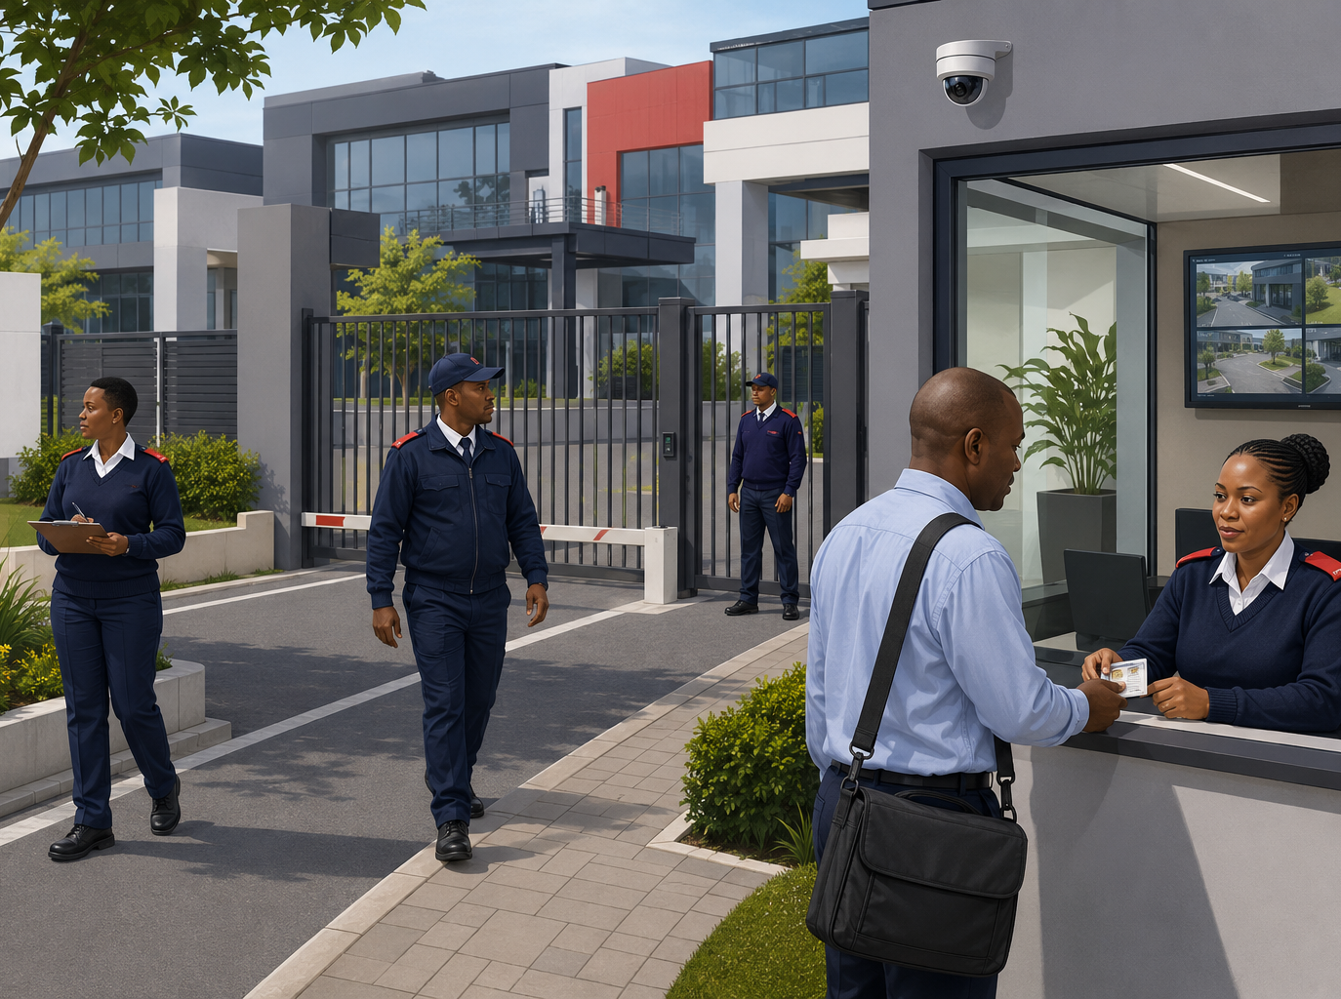
MUPO TRAINING CENTER
MODULE 8
MODULE 08 • 150 MINUTES
Guarding and Patrolling
TEACH THE ESSENTIALS
• Know post orders, patrol routes, communication methods and escalation contacts.
• Vary patrol timing where authorised and remain alert to routine changes.
• Check doors, windows, fences, lighting, hazards, vital points and emergency equipment.
FACILITATE
During night patrol you find an open rear door, fresh tool marks and no authorised work nearby. Explain your response.
GRADE E, D & C | 12
Notes:
Module 8: Guarding and Patrolling. Explain the essential knowledge, then use the scenario to elicit a safe sequence of actions. Ask learners to justify what they would communicate and record.
[Sources]
- Mupo Security Training, Grade E, D & C Training Manual, Publication Ready Edition 2.1 (user-provided).
- User-provided Mupo Training Center and Mupo Security Training logos and manual illustrations.
[/Sources]

Slide 13
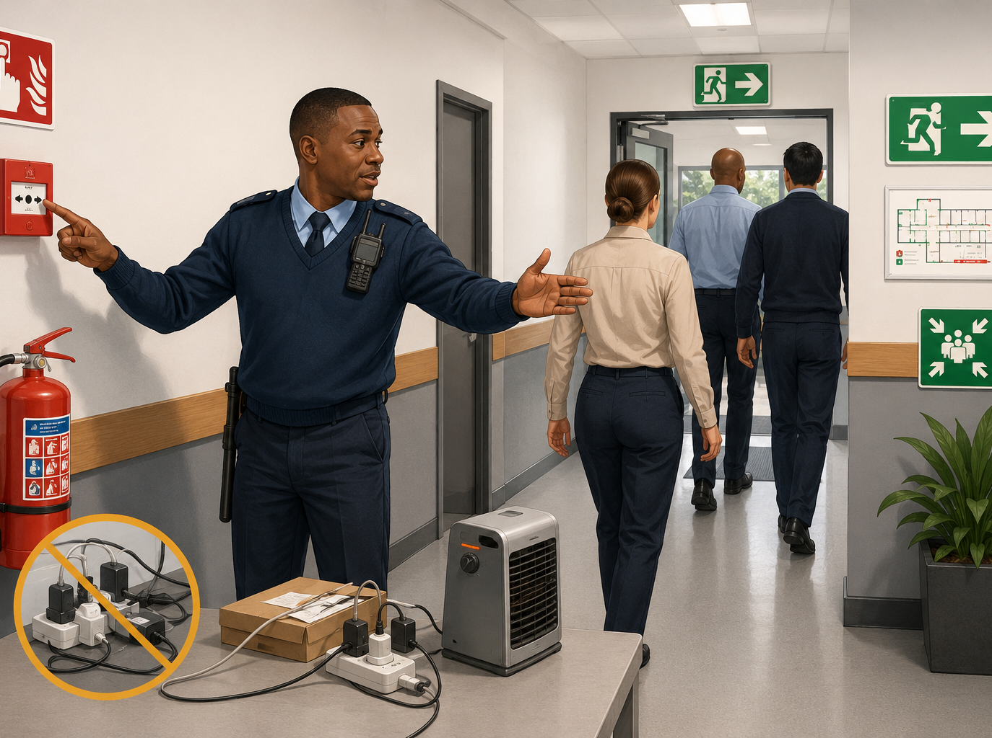
MUPO TRAINING CENTER
MODULE 9
MODULE 09 • 120 MINUTES
Firefighting, Prevention and Protection
TEACH THE ESSENTIALS
• Prevent fire through good housekeeping, safe electrical use and correct storage.
• Know alarm points, exits, assembly points and emergency contacts.
• On discovering fire: raise the alarm, protect life, call for help and follow the site plan.
FACILITATE
Smoke is coming from an electrical cabinet. State your priorities and explain when you should not attempt firefighting.
GRADE E, D & C | 13
Notes:
Module 9: Firefighting, Prevention and Protection. Explain the essential knowledge, then use the scenario to elicit a safe sequence of actions. Ask learners to justify what they would communicate and record.
[Sources]
- Mupo Security Training, Grade E, D & C Training Manual, Publication Ready Edition 2.1 (user-provided).
- User-provided Mupo Training Center and Mupo Security Training logos and manual illustrations.
[/Sources]

Slide 14
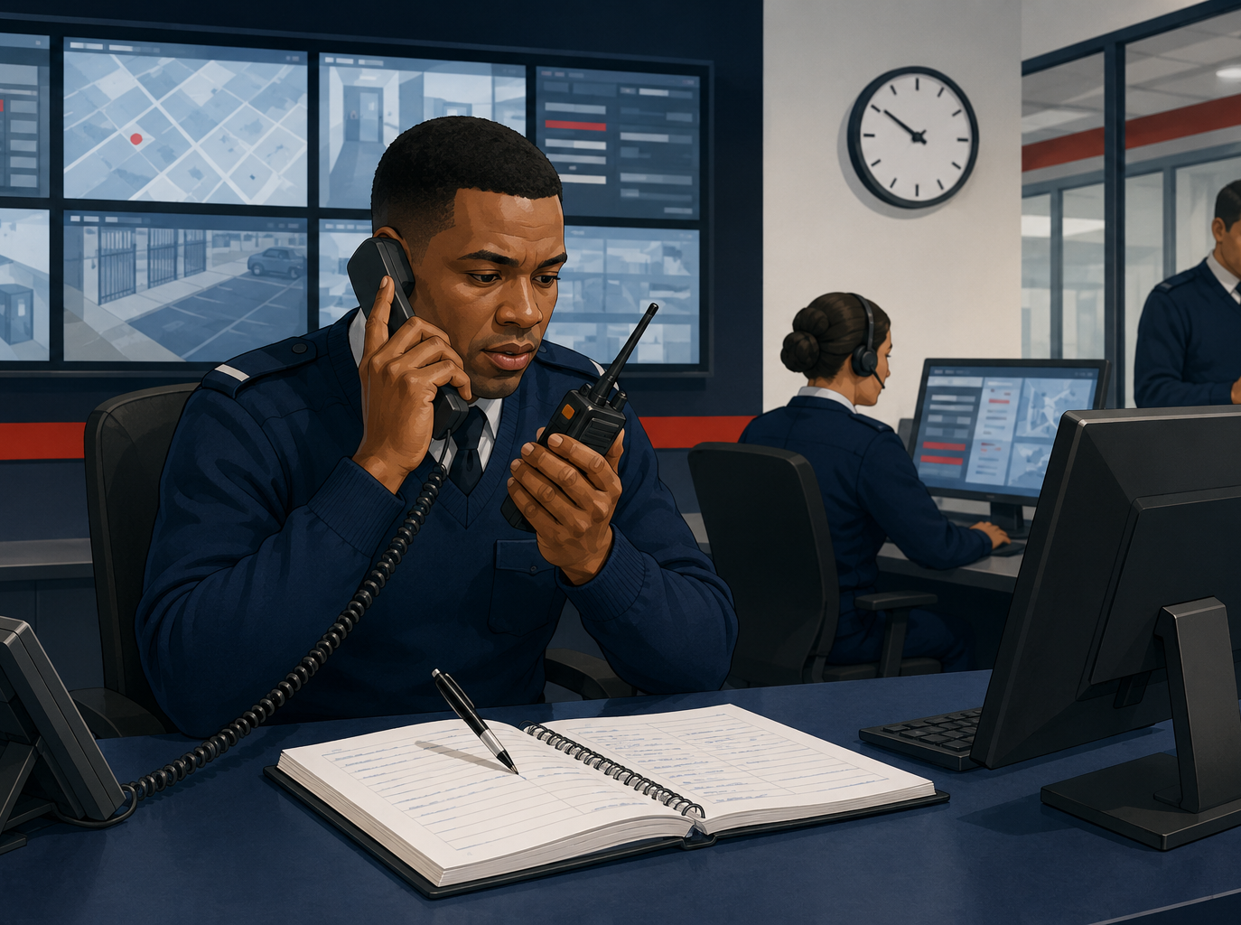
MUPO TRAINING CENTER
MODULE 10
MODULE 10 • 90 MINUTES
Radio and Telephone Communication
TEACH THE ESSENTIALS
• Answer promptly, identify the service and speak clearly.
• Listen, confirm important facts and repeat back critical details.
• Keep radio messages brief, accurate, professional and relevant.
FACILITATE
A noisy radio message reports a possible break-in. Demonstrate how to clarify, repeat back and record the message.
GRADE E, D & C | 14
Notes:
Module 10: Radio and Telephone Communication. Explain the essential knowledge, then use the scenario to elicit a safe sequence of actions. Ask learners to justify what they would communicate and record.
[Sources]
- Mupo Security Training, Grade E, D & C Training Manual, Publication Ready Edition 2.1 (user-provided).
- User-provided Mupo Training Center and Mupo Security Training logos and manual illustrations.
[/Sources]

Slide 15
MUPO TRAINING CENTER
MODULE 11
MODULE 11 • 180 MINUTES
Legal Aspects
TEACH THE ESSENTIALS
ASK
• Work only within registration status, training, assignment and lawful authority.
• Respect dignity, privacy and constitutional rights while protecting people and property.
• Arrest, search and force have legal limits; uncertainty must be escalated.
• Force must be necessary, proportionate and discontinued when the threat ends.
A suspect is detained after property is found nearby, but ownership is uncertain. Explain the lawful safeguards and escalation steps.
Evidence to listen for
Explain basic legal limits affecting security work.
GRADE E, D & C | 15
Notes:
Module 11: Legal Aspects. Explain the essential knowledge, then use the scenario to elicit a safe sequence of actions. Ask learners to justify what they would communicate and record.
[Sources]
- Mupo Security Training, Grade E, D & C Training Manual, Publication Ready Edition 2.1 (user-provided).
- User-provided Mupo Training Center and Mupo Security Training logos and manual illustrations.
[/Sources]

Slide 16
MUPO TRAINING CENTER
MODULE 12
MODULE 12 • 60 MINUTES
Industrial Relations
TEACH THE ESSENTIALS
ASK
• A disciplinary code communicates expected conduct and possible consequences.
• Rules should be lawful, known, reasonable and applied consistently.
• A grievance process allows concerns to be raised and resolved through proper channels.
• Record facts and avoid rumours, retaliation or public argument.
An employee complains that a workplace rule is being applied unfairly. Explain how to receive and refer the complaint professionally.
Evidence to listen for
Explain the purpose of discipline and grievance procedures.
GRADE E, D & C | 16
Notes:
Module 12: Industrial Relations. Explain the essential knowledge, then use the scenario to elicit a safe sequence of actions. Ask learners to justify what they would communicate and record.
[Sources]
- Mupo Security Training, Grade E, D & C Training Manual, Publication Ready Edition 2.1 (user-provided).
- User-provided Mupo Training Center and Mupo Security Training logos and manual illustrations.
[/Sources]

Slide 17
MUPO TRAINING CENTER
MODULE 13
MODULE 13 • 90 MINUTES
Occupational Safety
TEACH THE ESSENTIALS
ASK
• Identify hazards before beginning a task or entering an unfamiliar area.
• Obey prohibition, warning, mandatory and emergency-information signs.
• Use required personal protective equipment and inspect it before use.
• Keep routes, exits and work areas clear through good housekeeping.
An extension lead crosses a busy passage and an emergency exit is partly blocked. Identify the hazards and corrective actions.
Evidence to listen for
Recognise workplace hazards and unsafe conditions.
GRADE E, D & C | 17
Notes:
Module 13: Occupational Safety. Explain the essential knowledge, then use the scenario to elicit a safe sequence of actions. Ask learners to justify what they would communicate and record.
[Sources]
- Mupo Security Training, Grade E, D & C Training Manual, Publication Ready Edition 2.1 (user-provided).
- User-provided Mupo Training Center and Mupo Security Training logos and manual illustrations.
[/Sources]

Slide 18
MUPO TRAINING CENTER
MODULE 14
MODULE 14 • 120 MINUTES
Access Control
TEACH THE ESSENTIALS
ASK
• Apply site rules consistently to employees, visitors, contractors and vehicles.
• Verify identity and authority before granting access.
• Issue, control and recover passes or permits as required.
• Record entries, exits, deliveries and exceptions accurately.
A contractor has valid identification but is not on the authorised list. Explain your decision, communication and escalation.
Evidence to listen for
Explain why access is controlled and recorded.
GRADE E, D & C | 18
Notes:
Module 14: Access Control. Explain the essential knowledge, then use the scenario to elicit a safe sequence of actions. Ask learners to justify what they would communicate and record.
[Sources]
- Mupo Security Training, Grade E, D & C Training Manual, Publication Ready Edition 2.1 (user-provided).
- User-provided Mupo Training Center and Mupo Security Training logos and manual illustrations.
[/Sources]

Slide 19
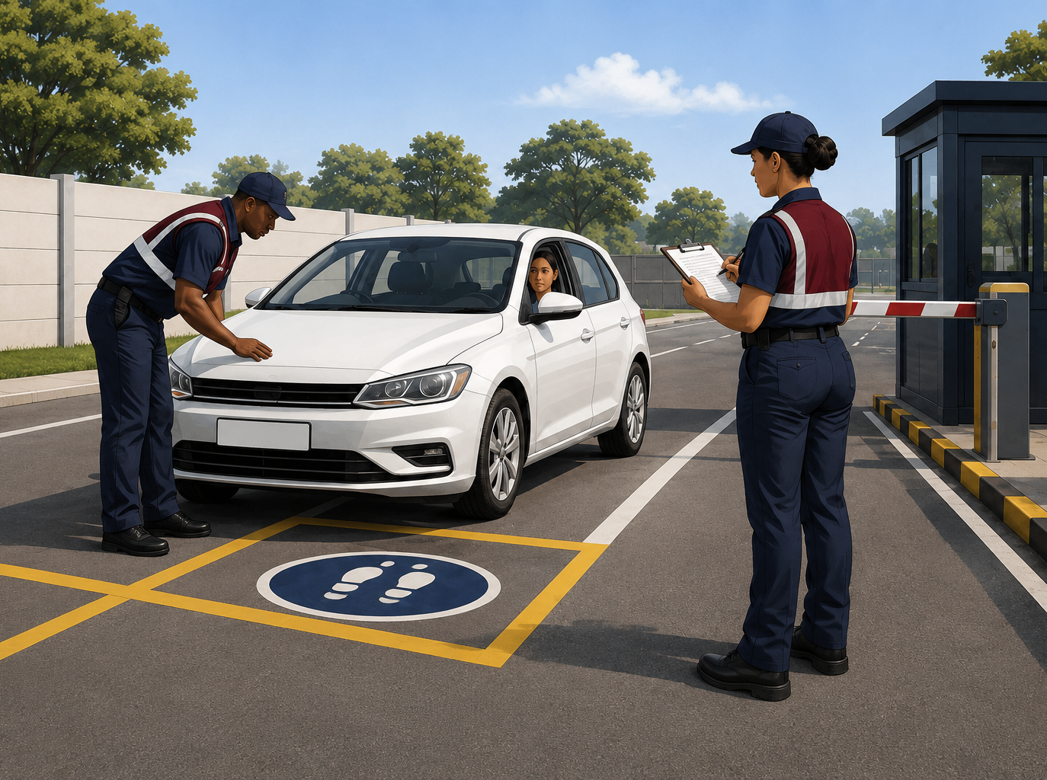
MUPO TRAINING CENTER
MODULE 15
MODULE 15 • 150 MINUTES
Search Procedures and Techniques
TEACH THE ESSENTIALS
• Confirm lawful authority or valid consent before a search.
• Explain the procedure, protect dignity and avoid discrimination.
• Use a systematic method and have suitable supervision or assistance.
FACILITATE
A visitor first agrees to a bag search and then withdraws consent. Explain the lawful response and access decision.
GRADE E, D & C | 19
Notes:
Module 15: Search Procedures and Techniques. Explain the essential knowledge, then use the scenario to elicit a safe sequence of actions. Ask learners to justify what they would communicate and record.
[Sources]
- Mupo Security Training, Grade E, D & C Training Manual, Publication Ready Edition 2.1 (user-provided).
- User-provided Mupo Training Center and Mupo Security Training logos and manual illustrations.
[/Sources]

Slide 20
MUPO TRAINING CENTER
MODULE 16
MODULE 16 • 90 MINUTES
Pocketbooks and the Occurrence Book
TEACH THE ESSENTIALS
ASK
• Record entries promptly in ink and keep them neat and chronological.
• Answer what, who, when, where, why and how.
• Do not remove pages, erase entries or use unexplained alterations.
• Record messages, instructions, incidents, property, arrests and irregularities.
At 22:15 you find a broken perimeter light and notify control. Draft an objective pocketbook entry.
Evidence to listen for
Maintain pocketbook and occurrence-book entries accurately.
GRADE E, D & C | 20
Notes:
Module 16: Pocketbooks and the Occurrence Book. Explain the essential knowledge, then use the scenario to elicit a safe sequence of actions. Ask learners to justify what they would communicate and record.
[Sources]
- Mupo Security Training, Grade E, D & C Training Manual, Publication Ready Edition 2.1 (user-provided).
- User-provided Mupo Training Center and Mupo Security Training logos and manual illustrations.
[/Sources]

Slide 21
MUPO TRAINING CENTER
MODULE 17
MODULE 17 • 90 MINUTES
Written Reports
TEACH THE ESSENTIALS
ASK
• A good report is accurate, concise, complete, objective, descriptive and honest.
• Use a clear heading and present facts in chronological order.
• Use numbered block paragraphs and helpful subheadings when required.
• Distinguish factual body content from comment or recommendation.
Using facilitator-provided facts about a gate incident, write a short chronological report and remove unsupported opinion.
Evidence to listen for
Write accurate, concise, complete and objective reports.
GRADE E, D & C | 21
Notes:
Module 17: Written Reports. Explain the essential knowledge, then use the scenario to elicit a safe sequence of actions. Ask learners to justify what they would communicate and record.
[Sources]
- Mupo Security Training, Grade E, D & C Training Manual, Publication Ready Edition 2.1 (user-provided).
- User-provided Mupo Training Center and Mupo Security Training logos and manual illustrations.
[/Sources]

Slide 22
MUPO TRAINING CENTER
MODULE 18
MODULE 18 • 90 MINUTES
The Threat
TEACH THE ESSENTIALS
ASK
• Threat level depends on factors such as time, place and the organisation’s product or service.
• Internal threats arise from authorised insiders; external threats arise from unauthorised outsiders or visitors.
• Threats include theft, fraud, robbery, sabotage, intimidation, espionage and malicious damage.
An employee shares restricted information with an unauthorised person. Explain how to protect information, evidence and people.
Evidence to listen for
Differentiate internal and external threats.
GRADE E, D & C | 22
Notes:
Module 18: The Threat. Explain the essential knowledge, then use the scenario to elicit a safe sequence of actions. Ask learners to justify what they would communicate and record.
[Sources]
- Mupo Security Training, Grade E, D & C Training Manual, Publication Ready Edition 2.1 (user-provided).
- User-provided Mupo Training Center and Mupo Security Training logos and manual illustrations.
[/Sources]

Slide 23
MUPO TRAINING CENTER
INTEGRATED PRACTICE
Strong responses follow four priorities
01
02
03
04
STOP
PROTECT
NOTIFY
RECORD
Pause unsafe action and assess from a safe position.
Protect life, dignity, access and possible evidence.
Use the authorised chain, emergency plan or police support.
Capture facts, times, persons informed, actions and outcome.
Practice prompt: A contractor dispute occurs while a suspicious bag is reported near the entrance. What happens first—and why?
GRADE E, D & C | 23
Notes:
Run the integrated prompt in small groups. Require each group to state priorities, delegation, communication and records. Correct any suggestion to touch the bag or bypass access controls.
[Sources]
- Mupo Security Training, Grade E, D & C Training Manual, Publication Ready Edition 2.1 (user-provided).
- User-provided Mupo Training Center and Mupo Security Training logos and manual illustrations.
[/Sources]

Slide 24
Assessment evidence must show more than recall
KNOWLEDGE
The learner can explain the rule.
APPLICATION
The learner can choose and justify safe action.
PRACTICAL
The learner can demonstrate the required behaviour.
RECORD
The result, feedback and sign-off are retained.
Use the current provider-approved assessment and moderation process.
SAFE • LAWFUL • PROFESSIONAL
Notes:
Close by confirming next steps: workbook completion, practical observation, assessment conditions, feedback and records. Do not announce a pass threshold unless it is the current provider-approved standard.
[Sources]
- Mupo Security Training, Grade E, D & C Training Manual, Publication Ready Edition 2.1 (user-provided).
- User-provided Mupo Training Center and Mupo Security Training logos and manual illustrations.
[/Sources]

